Slide 1
Evidence of brain-derived neurotrophic factor in ameliorating cancer-related cognitive impairment

Slide 2
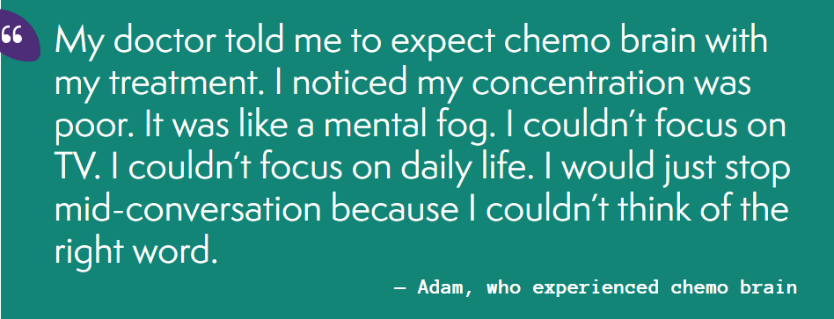
Who gets chemo brain?
Many people are affected by cancer experience chemo brain. It can affect people who:
are newly diagnosed with cancer
are having any treatment for cancer, not only chemotherapy
have been recently treated for cancer
are in remission (no evidence of lymphoma on tests scans) for some time.

Slide 3
There are two forms of BDNF in human brain: the BDNF precursor (proBDNF) and mature BDNF (mBDNF)

Slide 4
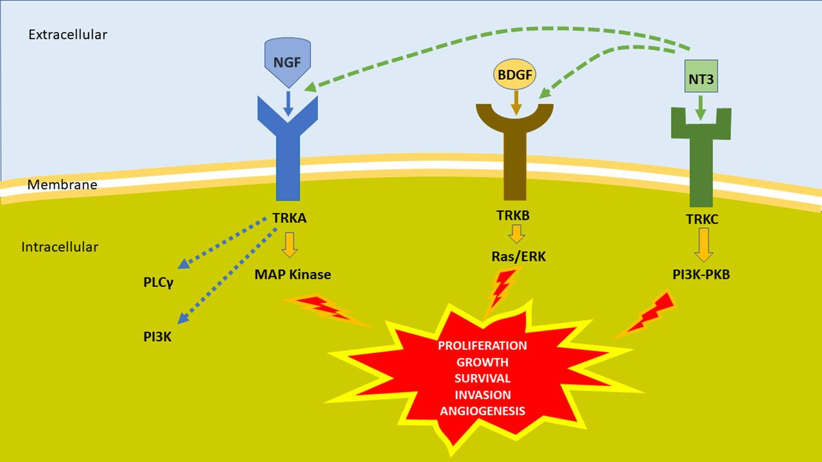

Slide 6
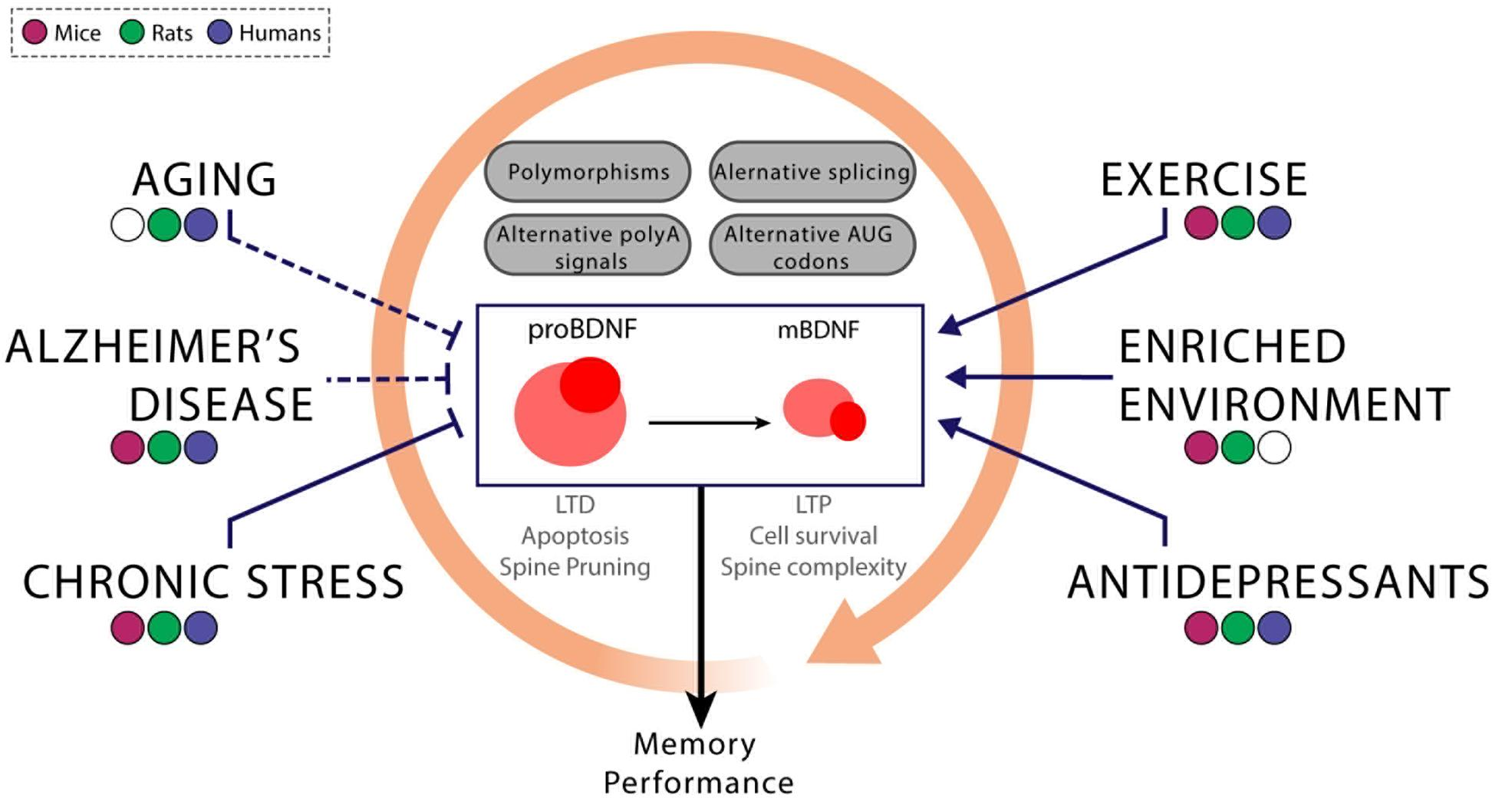
Many factors, including age, degree of exercise and single nucleotide polymorphisms (SNPs) of the BDNF gene, may impact BDNF levels and subsequently cognitive performance, suggesting that BDNF is an important target for the study of cognitive health.

Slide 7
It is postulated that the neurotoxic effects of chemotherapy on BDNF expression can occur after the completion of chemotherapy and in cancer survivors, resulting in CRCI.
A total of 10 observational studies assessed the association between BDNF levels and cognitive performances. Of these studies, five (50 %) demonstrated a positive association. Four of these studies revealed a positive association between BDNF levels and objective cognitive tests, including patients diagnosed with multiple myeloma, metastatic cancer, B-cell non-Hodgkin lymphoma (B-cell NHL), and hepatocellular carcinoma (HCC). One study evaluated intra-tumoral levels of BDNF in diffuse glioma patients and reported a negative association with memory.

