Slide 1
Nutritiology in today's world: benefit or harm. How does immunology affect our daily lives?
Vsevolod Oshkin

Slide 2
What is the problem that we all face today?

Slide 3
A lot of fake medical information in our digital space

Slide 4
CLINICAL CASE FROM MY MEDICAL PRACTICE
A story about a fake medical doctor without medical education who could prescribe a correction of blood test results FOR CHILDREN (OMG!). Her age was 20 y.o. She was a nutritiologist. But in reality she was an obscurantist.

Slide 5
WHAT SHOULD WE DO?

Slide 6
A solution of the problem is to follow knowledgeable medical influencers.

Slide 7
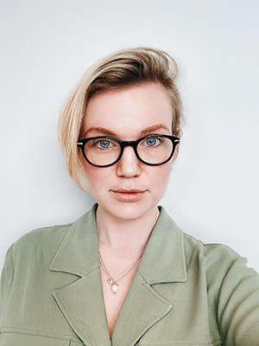
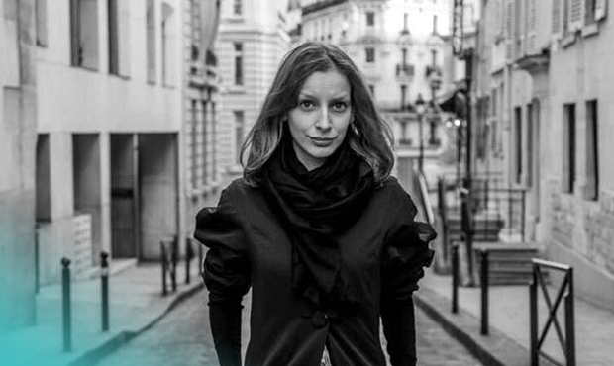
WHO ARE THEY?

Slide 8
WHO ARE THEY?
1. Maria Kardakova is a nutritiologist and a public health specialist in the United Kingdom. She studies the effects of different foods on the human gut microflora. 2. Daria Kartasheva–Eberz is an immunologist living in France.

Slide 9
Write me in direct messages after this presentation. I will send you links to their profiles and other social media.

Slide 10
Thank you for your attention!

