Slide 1
Risk Factors for cancer associated thrombosis
Selima Uzueva
Hematologist

Slide 2
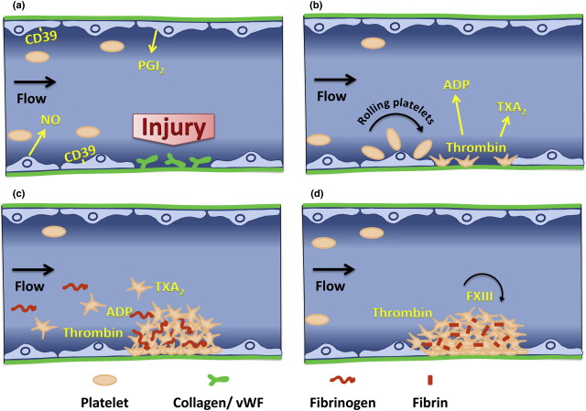
Blood clotting
Injury to blood vessels triggers activation of blood clotting
Highly regulated process
Blood clotting is switched off once the injured vessels has healed and bleeding has stopped

Slide 3
Risk factors for cancer-associated thrombosis
Tumor factors
The risk of a blood clot is greater in the first few months after a cancer diagnosis, the time when treatment generally occurs.
Some cancers pose a greater risk for blood clots, including cancers involving the pancreas, stomach, brain, lungs, uterus, ovaries, and kidneys, as well as blood cancers, such as lymphoma and myeloma.
The higher your cancer stage, the greater your risk for a blood clot.

Slide 4
Risk factors for cancer-associated thrombosis
Treatment factors: the administration of chemotherapy and/or hormone therapy, transfusion, surgical interventions, the presence of an indwelling central venous catheter.
The specific type of cancer treatment you receive can increase your risk for blood clots.
Treatments involving hospitalization, surgery, chemotherapy, treatment with hormones, and catheters (small tubes placed in veins to administer various treatments) can increase your risk for blood clots.

Slide 5
Risk factors for cancer-associated thrombosis
Patient factors: previous VTE, family history of VTE, obesity, smoker.
Previous blood clot
Family history of blood clots or inherited clotting disorder
Hospitalization for illness or major surgery, particularly of the pelvis, abdomen, hip, or knee
Broken bone or severe muscle injury
Serious medical conditions, such as heart and lung diseases, or diabetes
Sitting too long, such as traveling for more than 4 hours, especially with legs crossed
Other causes of immobility, such as extended bedrest
Overweight and obesity
Smoking

Slide 6
Thrombosis is a leading cause of illness and death among people with cancer
VTE is a common complication among patients with cancer, who account for approximately 20% of all VTE cases.
Patients with cancer and VTE are at a markedly increased risk of recurrent VTE and early death.
The occurrence of VTE in patients with cancer may interfere with planned chemotherapy regimens, worsen patient quality of life, use scarce health care resources, and increase the risk of mortality.

Slide 7
Strategies to reduce risk thrombosis in cancer
Raising awareness among healthcare professionals
Raising awareness among patients

Slide 8
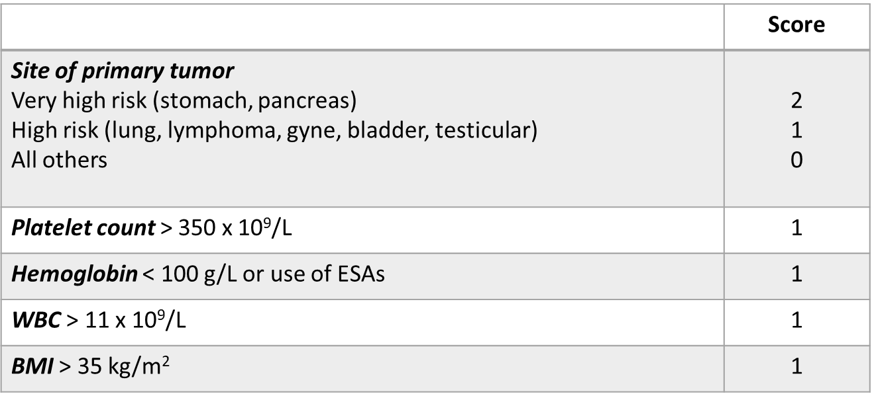
Risk assessment: Khorana score

Slide 9
If you have any questions please keep it for yourself… I’m not

