Slide 1
OCULAR IMMUNE SYSTEM
Anna Kravchenko
ophthalmologist
resident of Lomonosov MSU

Slide 2
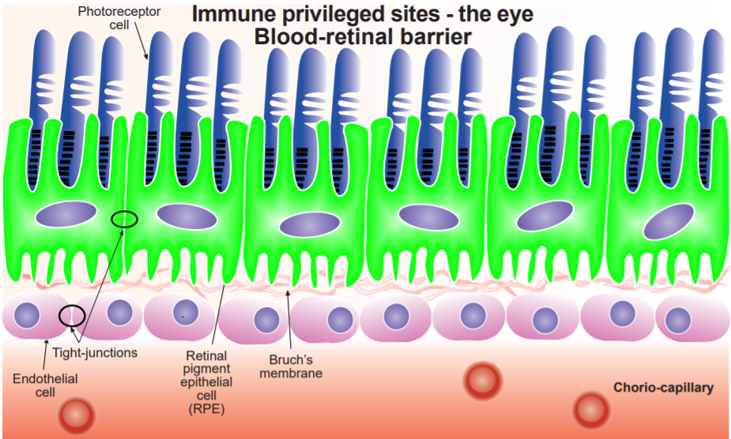
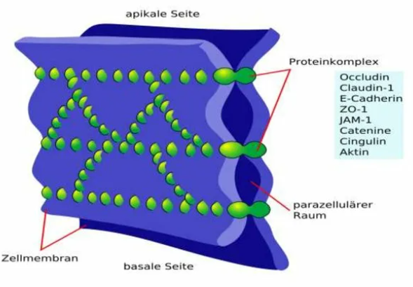

Slide 3
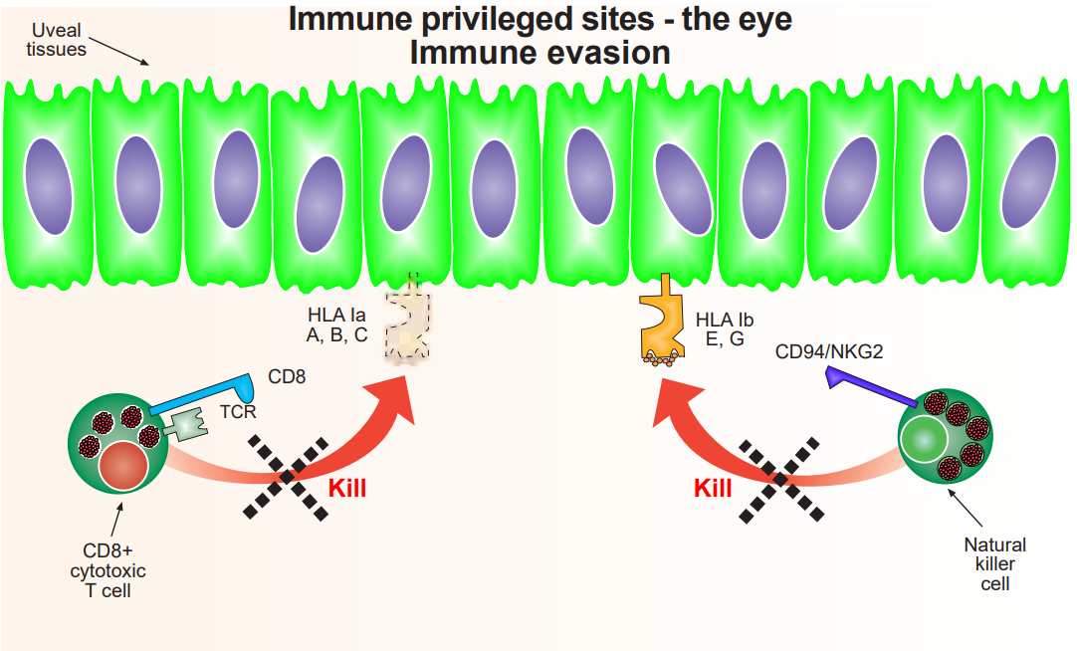

Slide 4
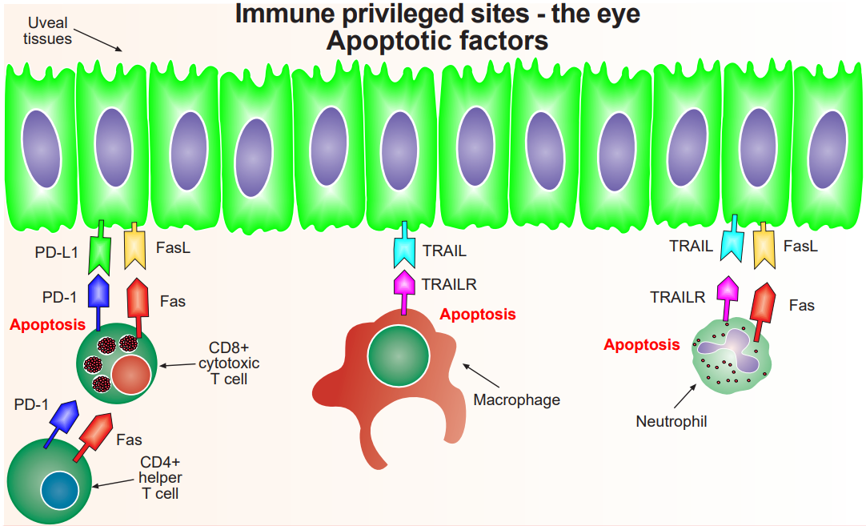

Slide 5
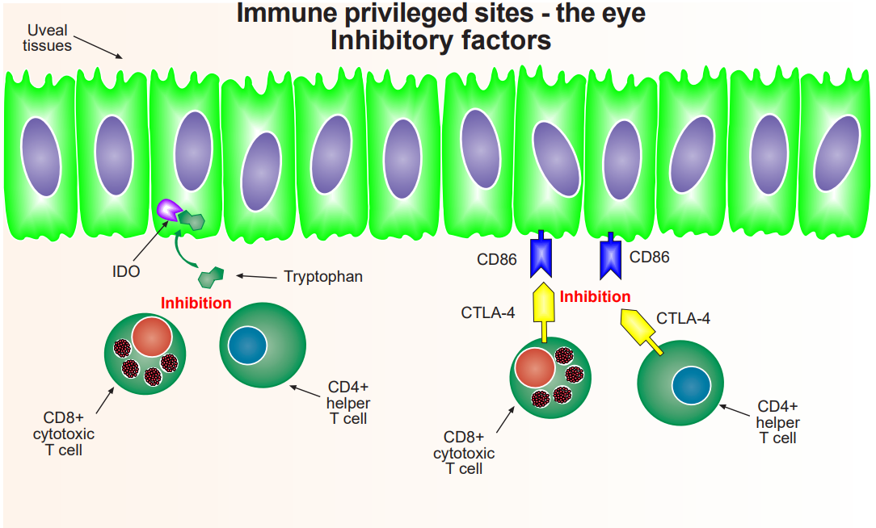

Slide 6
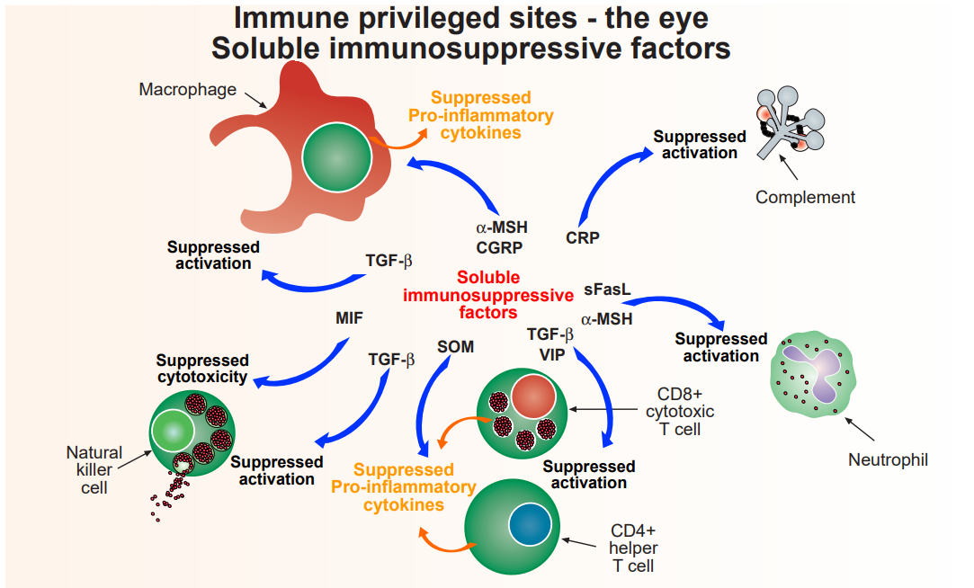

Slide 7
